Slide 1
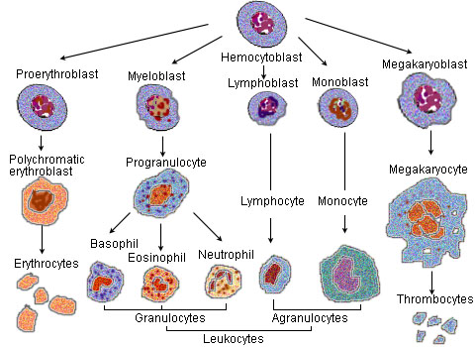
Myelosuppression
Anemia
Hb < 10 g/dL
Neutropenia
Neutrophils = Segs + Bands
Thrombocytopenia
Platelets < 10,000 cells/mm³
Notes:
thrombocytopenia 27 - 28
Neutropenia 28 - 45
Anemia 46 – 56

Slide 2
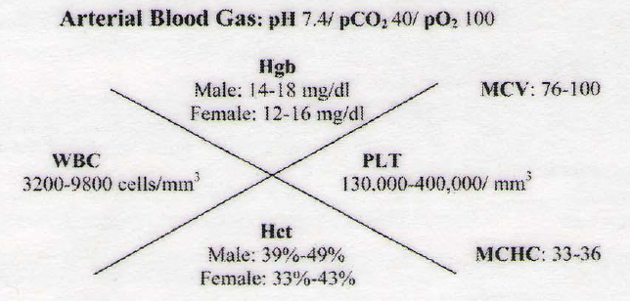

Slide 3
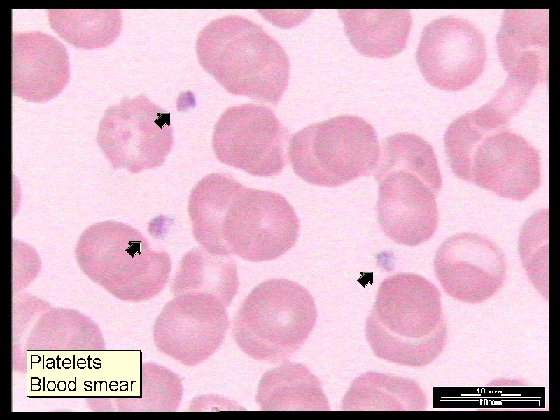
Thrombocytopenia
Nadir 2 – 3 weeks after Chemo:
Are
Platelets < 100,000 cells/mm³?
If Yes
D/C Chemo
Are
Platelets < 20,000 cells/mm³?
If Yes
Give platelet transfusions

Slide 4
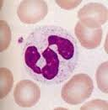
Neutropenia = infection
ANC = WBC x % neutrophils (segs + bands)
Grade | ANC
Grade 0 | > 2000
Grade 1 | 1500 – 2000
Grade 2 | 1000 - 1500
Grade 3 | 500 – 1000
Grade 4 | < 500
Febrile Neutropenia | Fever > 100.5 ANC < 500
Check ANC
If
ANC < 1500
If
ANC > 1500
D/C Chemo
Cont Tx
Fever > 100.5?
Fever
No-Fever
Wait until ANC > 1500 then:
Reduce next Chemo dose by 25%
+/-
Cell Growth Factor (CSF)
Add
Antibiotics

Slide 5
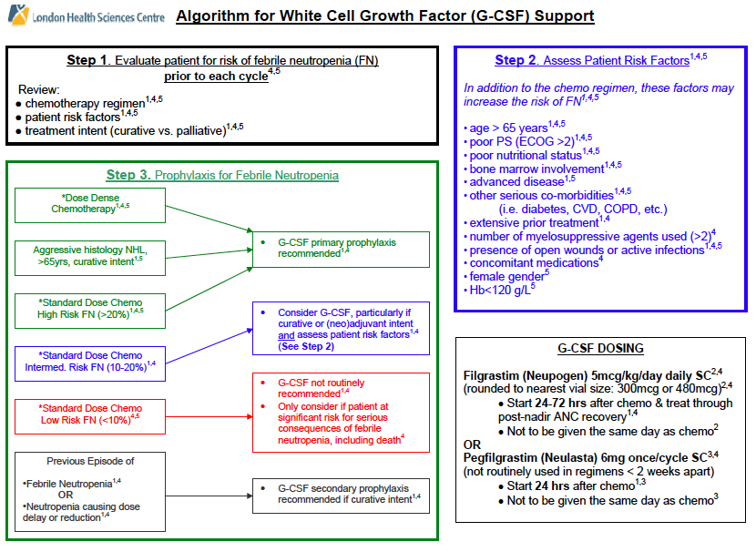

Slide 6
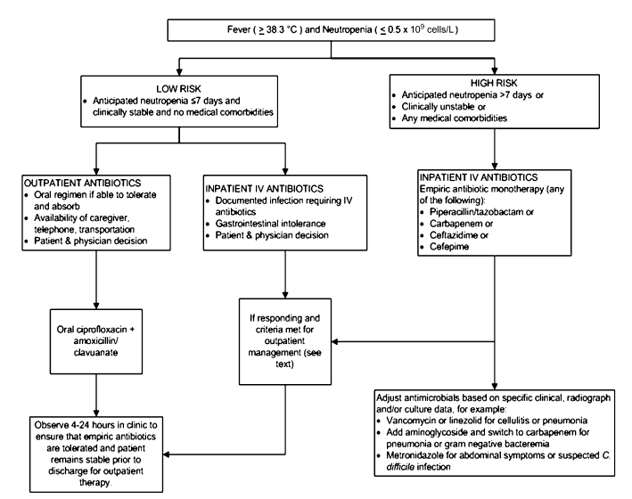
Antibiotics

Slide 7
IDSA guidelines
(from Symptom management packet slide 40)
Neutropenic Fever = Febrile neutropenia + fever
Classification of Neutropenia
Mild neutropenia (1000 ≤ ANC < 1500) — minimal risk of infection
Moderate neutropenia (500 ≤ ANC < 1000) — moderate risk of infection
Severe neutropenia (ANC < 500) — severe risk of infection.

Slide 8
Risk vs Low risk Neutropenic Fever definitions
> 7 day duration
ANC < 100 cells/mm³ following cytotoxic chemo
HyPOtension
Pneumonia
New-onset abdominal pain
Neurologic changes
Low-risk pts neutropenic fever:
< 7 days duration
No or few comorbidities

Slide 9
Antibiotic use for Neutropenic Fever (p2)
Antipseudomonal B lactam Drug | Use Next if
Piperacillin-tazobactam | B lactam allergy
Cefepime (4th gen cephalo) | Severe B lactam allergy
Carbapenem (broad spectrum)
+/-
If | Add
MRSA | Vanco
VRE | Linezolid
Fever 4 – 7 days after antibacterial | Antifungal
ANC < 100 cells/m for > 7 days | FQ – Levofloxacin
Duration of antibiotic therapy p3
Continue until ANC > 500 cells/mm³

Slide 10
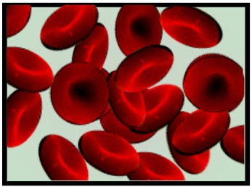
Anemia = Low RBC
Affects quality of life when Hb < 10 g/dL
NOT a dose limiting side effect
S/S Fatigue and SOB
Then check Hb
If
Hb < 10 g/dL
Give:
Procrit (epoetin) 40,000 u SC q week
or
Aranesp (darbepoetin) 200 mcg SC q2wk or 500 mcg q3wk.
If TSAT < 20 then
Add: Fe supplementation
EPO Monitor:
Thrombosis, HTN
If Hb > 12 g/dL
Then D/C EPO due to risk of thrombosis
Wait until Hb drops and restart EPO at lower dose

Slide 11
